Slide 1

ENGLISH PROJECT
STUDENT: Giorgi Peradze
FACULTY: Computer Science

Slide 2

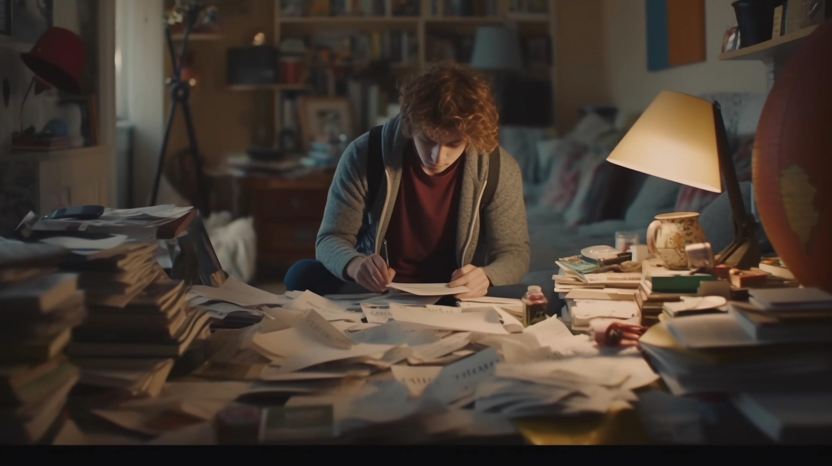
How to start a business with a little money?

Slide 3

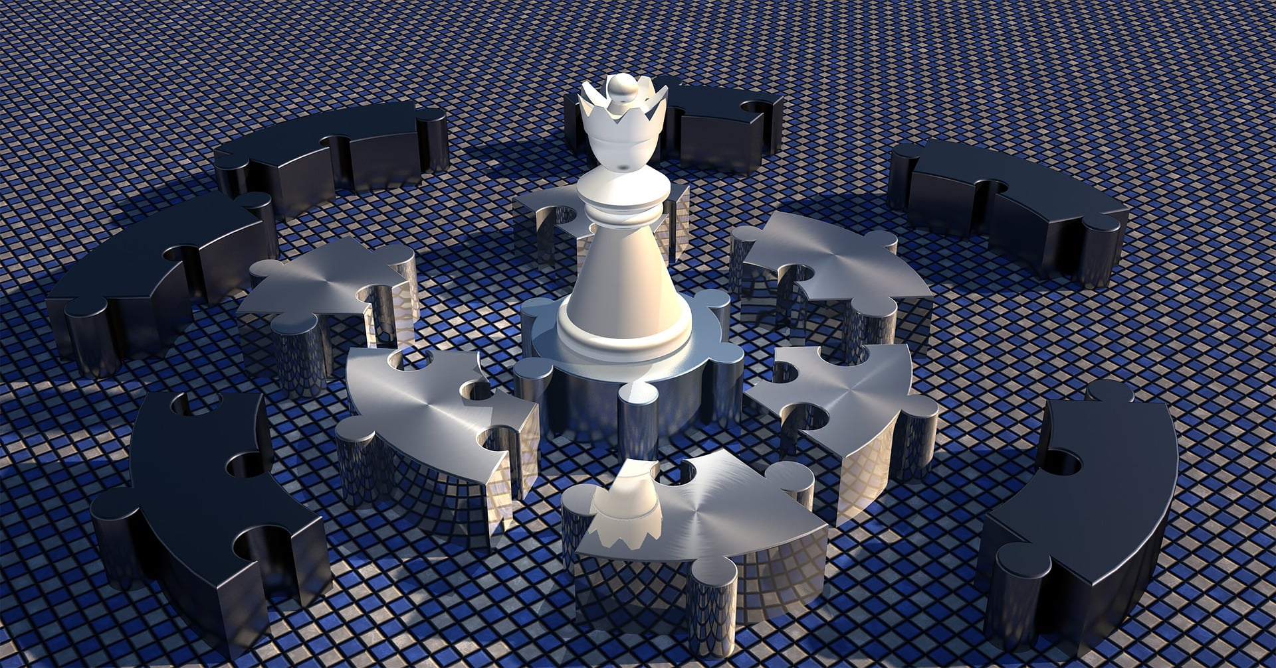
Be confident start communicating with people who have same intereses or goals take as an example a person who started like u and reached a tops set a direct plan
How to deal with Problems in first steps

Slide 4
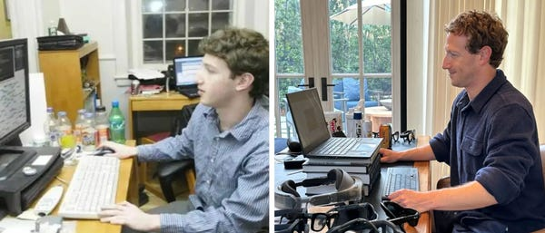
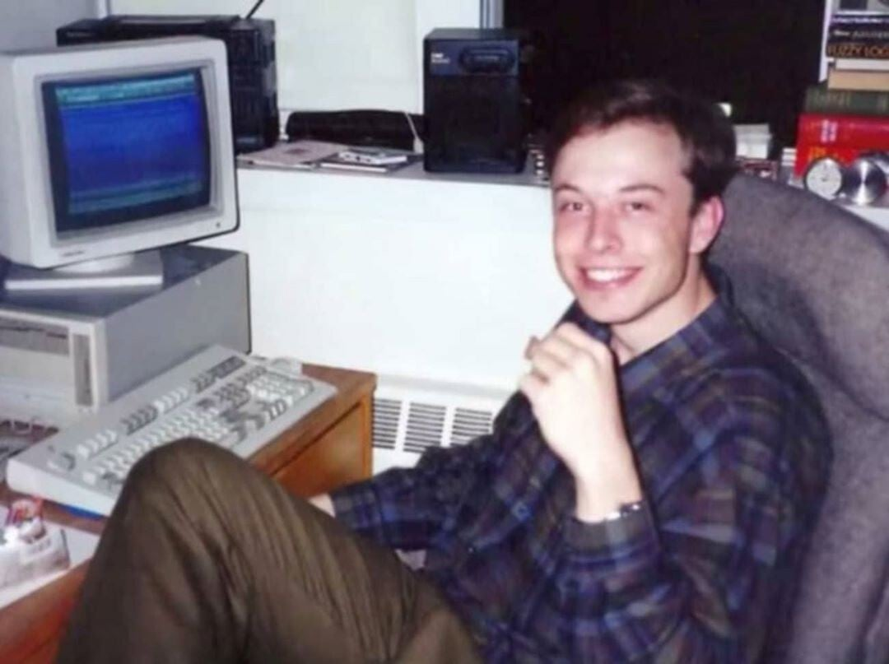
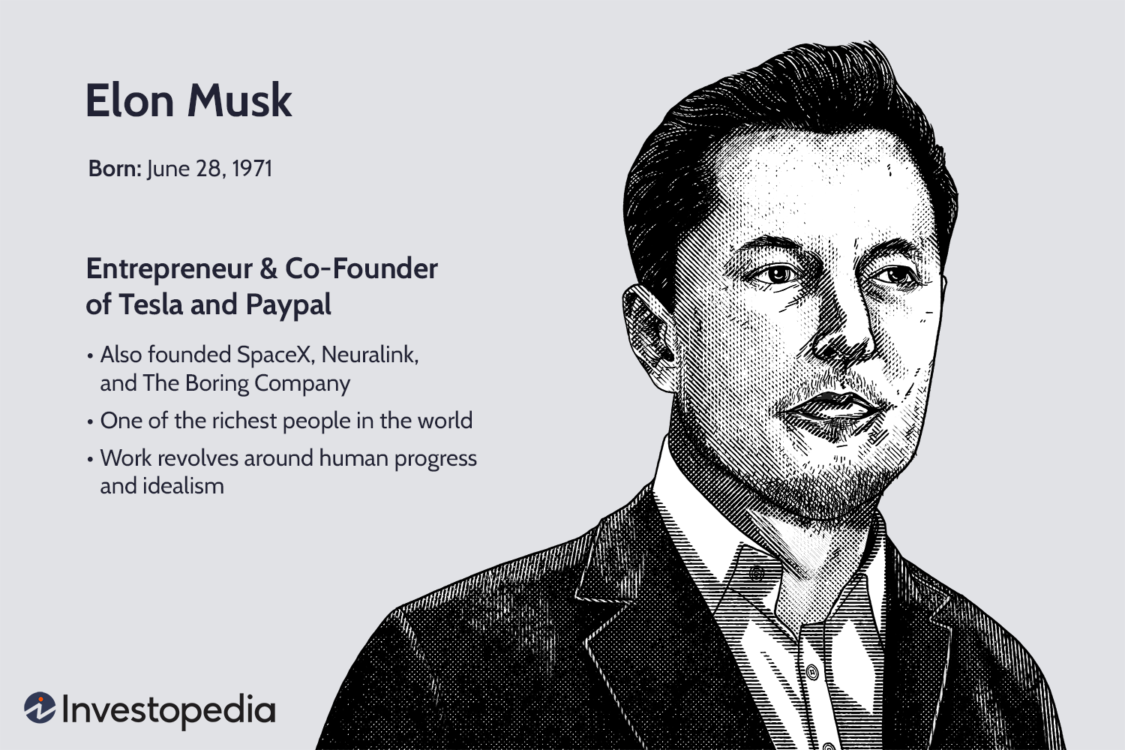
Staring is hard for every one but winners get everything Take an example from Elon Mask, Mark Zuckerberg and etc.

Slide 5
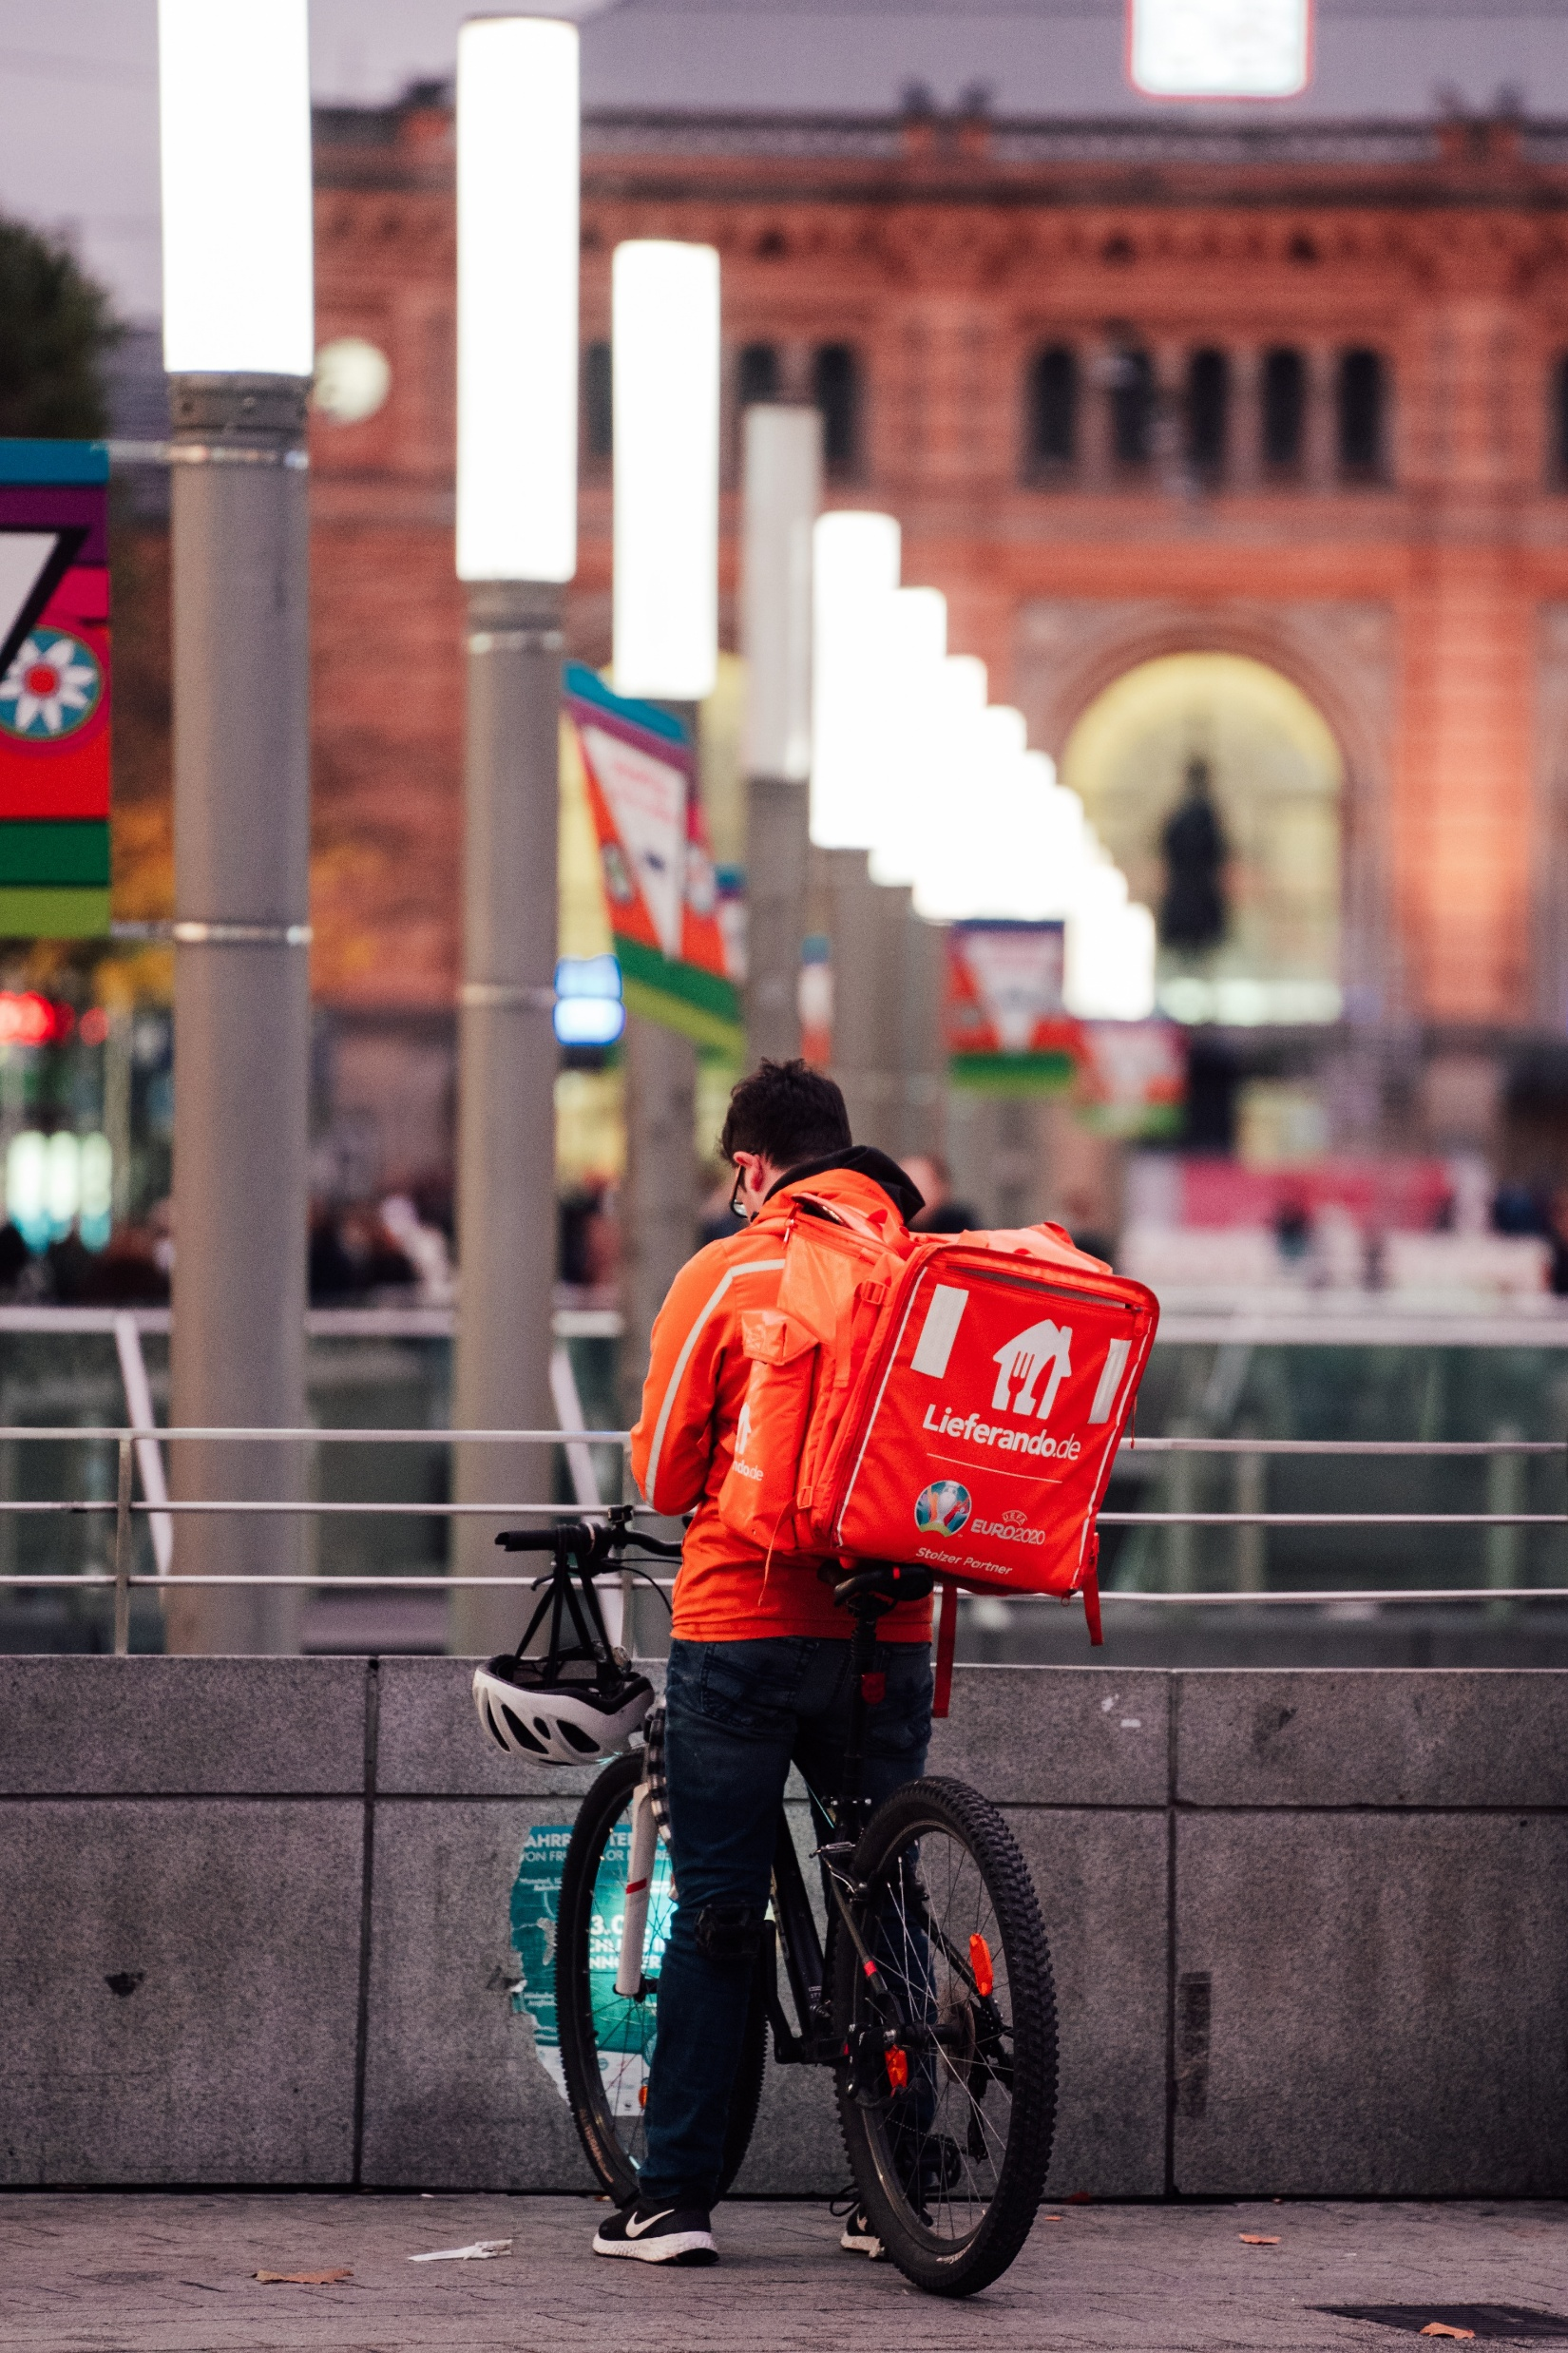
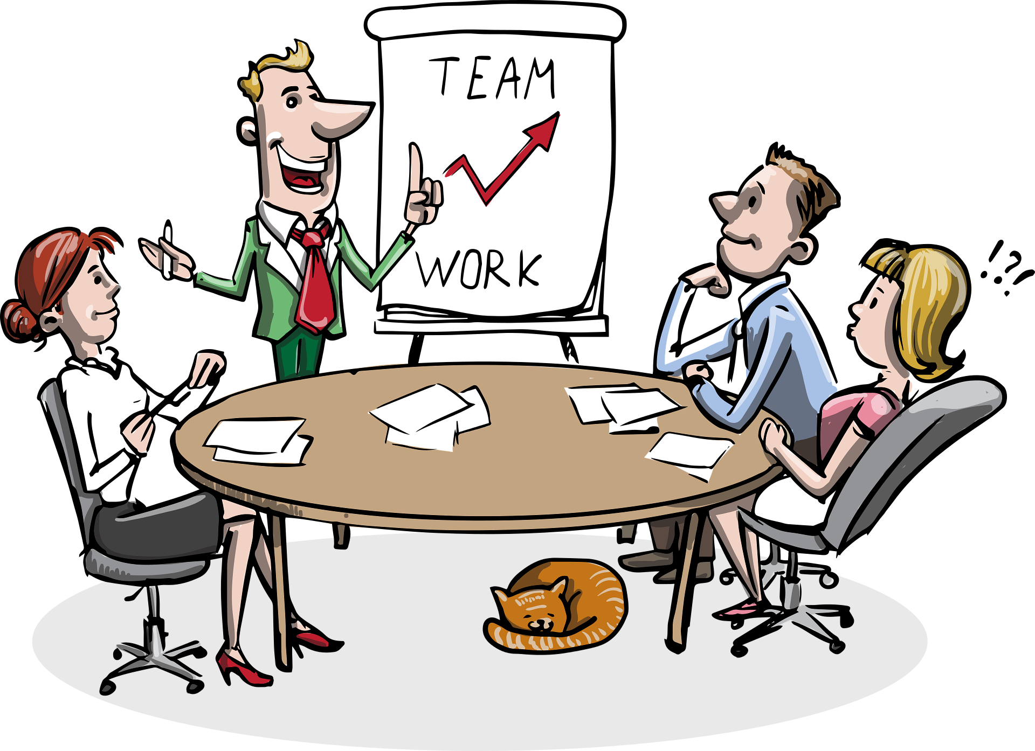
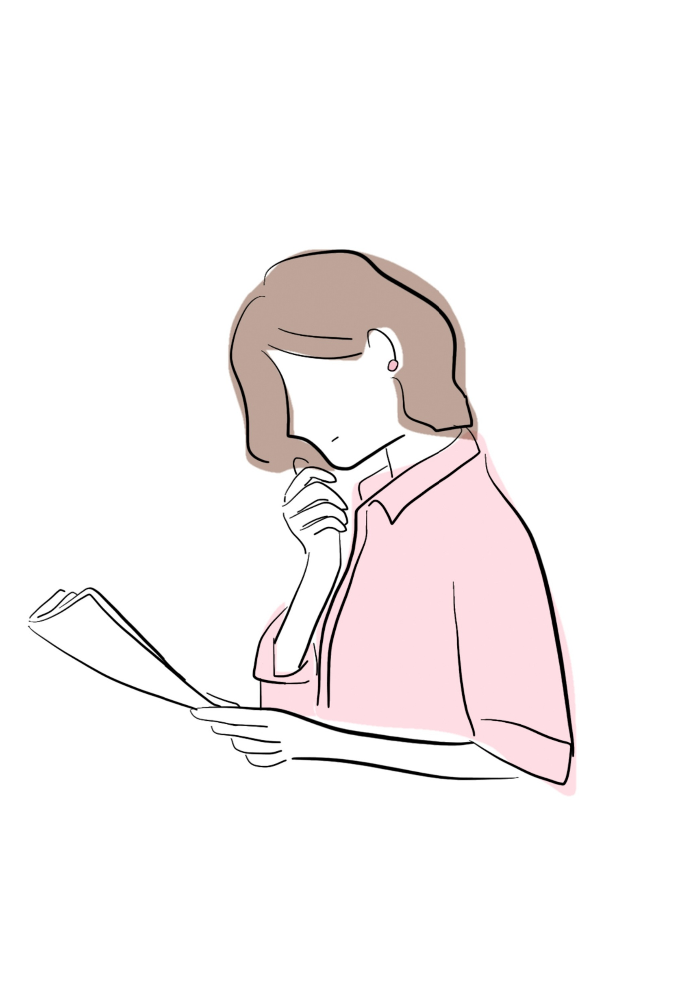
First and the main rule is get a plan
Find easy work for students to get little amount of money
Make a product and good presentation about it
find investors

Slide 6
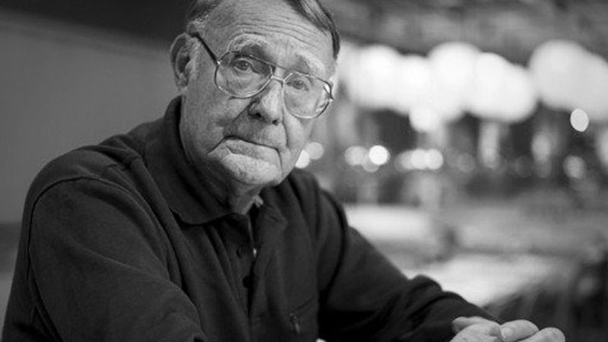
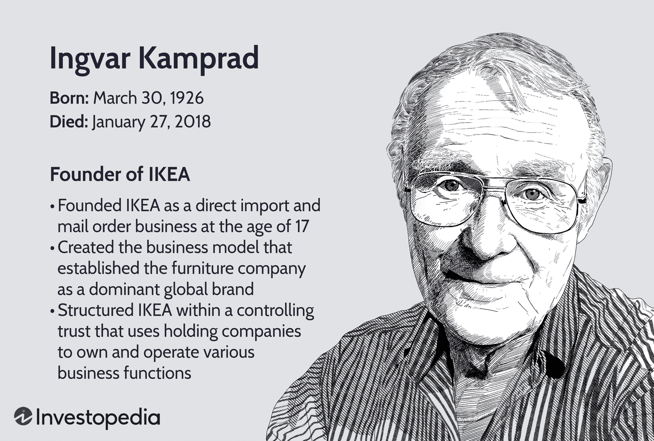
Ingvar Kamprad, the founder of IKEA

Slide 7
summary
Never backup no matter what
Always see bright in ur work
Set a good plan
Be confident
Rememeber Richest people come from nothing

Slide 8
Thanks for ur attention!!!
Used materials:
https://www.google.com
https://pixabay.com

